Slide 1
Random Survival Forest
A Machine Learning Method for Survival Analysis
Sin U Choi
DATASCI 224
06/01/2026

Slide 2
Why Do We Need RSF? The Censoring Problem
Patient 1
💀
Patient 2
❌
Patient 3
💀
→ Censored — outcome unknown
Patient 4
❌
✗ Event observed
→ Censored — outcome unknown
Year 0
Year 4
Year 8
Standard Random Forest
✗ Needs complete outcome for every patient
✗ Cannot handle censored data
✗ Built for regression and classification
Random Survival Forest
✓ Designed for censored survival data
✓ Uses log-rank test — familiar from KM curves
✓ No proportional hazards assumption needed
Ishwaran et al. invented RSF in 2008 to solve exactly this problem.
Notes:
Before explaining RSF, I need to explain why standard Random forest cannot handle survival data. Look at this timeline, Patient 1 died at year 4 that is a complete outcome. But patient 2 was still alive when the study ended. We know they survived at least 8 years, but we do not know when they will die. Censoring is an incomplete outcome we cannot igore or throw away. Standard Random Forest needs a complete outcome for every patient. It was built for regression and classification. It has no mechanism for handling this unknown information. RSF solves this by using log-rank test as its splitting criterion, the same test that was used to compare 2 KM curves. It was designed specifically for censored survival data. That was Ishwaran’s key insight in 2008.

Slide 3
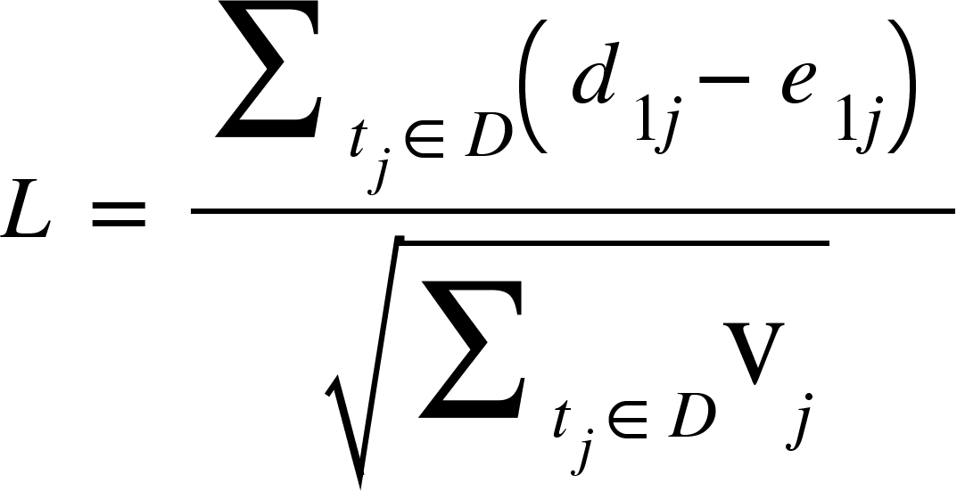
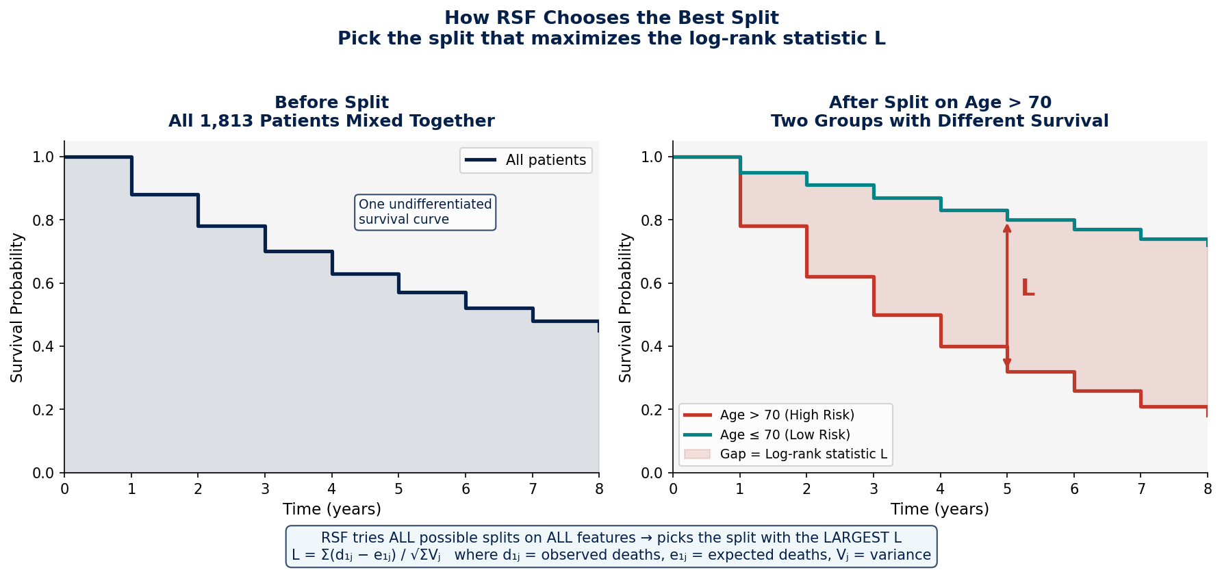

How RSF Splits Patients: The Survival Tree
All 1,813 patients
Ask: Is age > 70?
How RSF Splitting Works
Log-rank test: used to compare two Kaplan-Meier curves
Yes
No
Older patients
Higher risk group
Survival drops faster
Younger patients
Lower risk group
Survival stays higher
$d_{1j}=$ the observed number of deaths in child node 1 at time t
$e_{1j}=n_{1j}∙\frac{d_{j}}{n_{j}}$ = the expected number under the null hypothesis of equal survival between child nodes
$V_{j}=$ the hypergeometric variance at time $t_{j}$
$D=$the set of all unique death times.
Notes:
So how does RSF build a tree? It starts with all your patients at the top node and asks a yes/no question. For example, is age greater than 70? This splits patients into two groups. The key challenge is deciding which split is the best. RSF answers this using the log-rank statistic. At each node, it tries every possible split on every covariate and picks the one that creates the most different survival experiences between the 2 child groups. The larger the log-rank statistic, the better the split. Once the tree is fully grown, each terminal leaf contains patients with similar survival. The Nelson-Aalen estimator then computes a cumulative hazard step function for that leaf and this becomes the predicted survival curve for any new patient who lands in that leaf. At each node, RSF doesn't consider all features. It randomly selects only the square root of p candidates. In our analysis with 22 dummy-expanded features, that's about 5 per split. This randomization is what makes it a forest rather than just a tree and will be explained in the next slide.

Slide 4
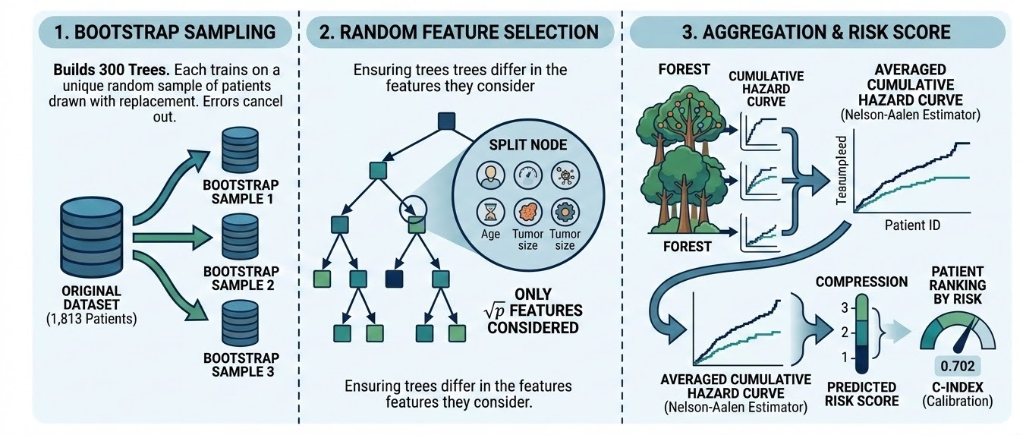
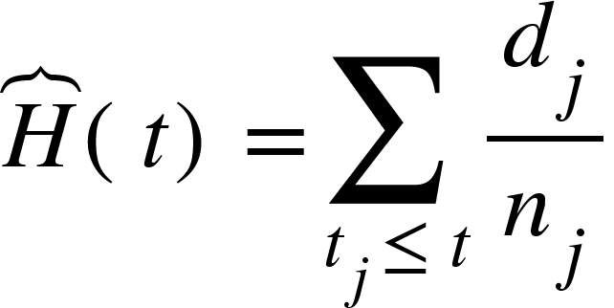
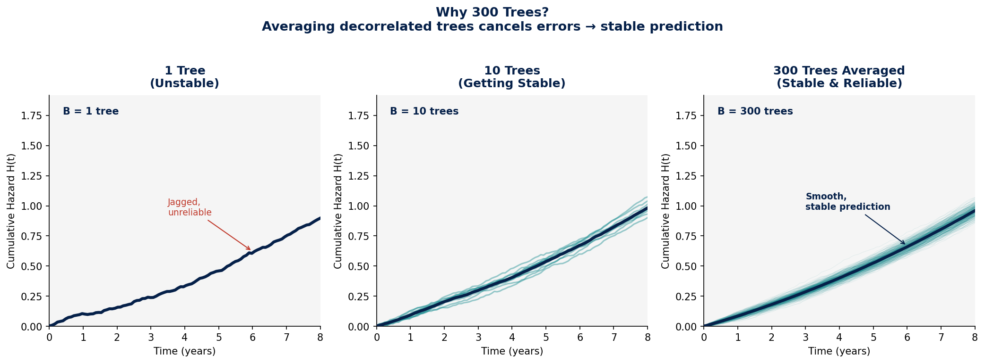
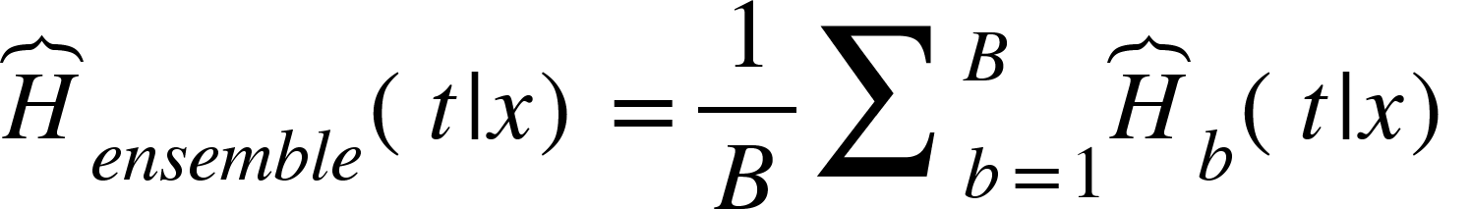

From One Tree to a Forest of 300
Nelson-Aalen (Terminal Node Prediction:
$d_{j}=$ the number of deaths
$n_{j}=$ the number at risk at time $t_{j}$.
Ensemble Prediction:
B = total # of trees
t = time point of interest
x = patient’s covariate values
Notes:
A single decision tree is unstable. Small changes in the training data can produce a completely different tree structure, and that is unreliable for prediction.
RSF addresses this through three steps.
First, bootstrap sampling. For each of the 300 trees, RSF draws a different random sample of patients with replacement. About 63% of patients are unique per tree. The 37%^ not sampled are called OOB patients, which provide free built-in validation without needing a separate test set.
Second, random feature selection. At each node, only square root of p features are considered. This ensures trees differ in 2 ways, different patients and different features. The result is 300 decorrelated trees that learned slightly different patterns and each made slightly different errors.
Third, ensemble prediction. A new patient is dropped down all 300 trees simultaneously. Each tree assigns them to a terminal leaf and produces a cumulative hazard curve. The 300 curves are averaged into one final ensemble prediction. This curve is then compressed into a single number called predicted mortality, that is by summing the cumulate hazard across all observed death times. Higher predicted mortality means higher risk.
when you average 300 decorrelated trees, errors cancel out and you get a stable, reliable prediction, like getting independent opinions from 300 doctors and taking the average.

Slide 5
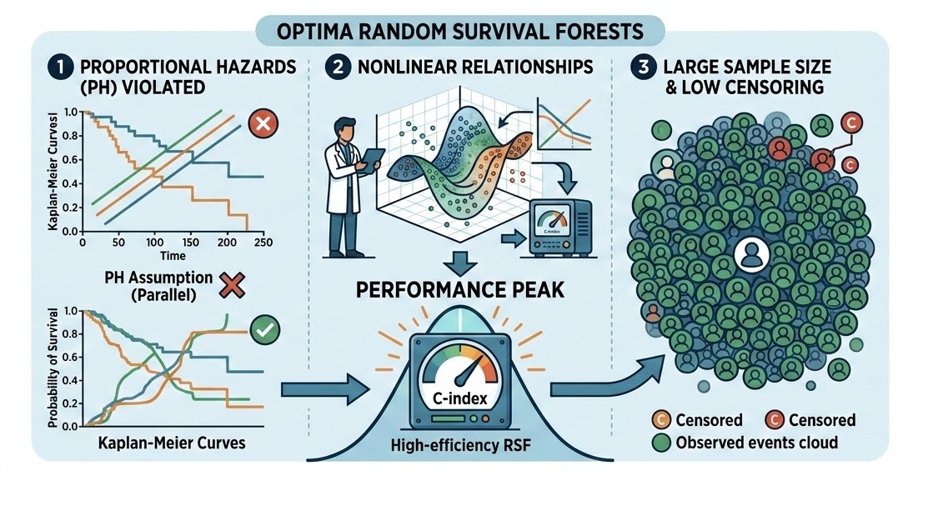
When does RSF Performs Best?
Notes:
RSF performs best under 3 conditions.
First, when the proportional hazards assumption is violated, In our CaPSURE dataset, we actually had 3 proportional hazard violations: treatment modality, age at FFQ, and years from diagnosis to FFQ all had statistically significant Schoenfeld residuals. So RSF was theoretically well-motivated.
Second, when relationships between covariates and survival are nonlinear or involve interactions. RSF captures these automatically without needing pre-specification, unlike cox which requires you to specify splines or interaction terms manually.
Third, when sample size is large and censoring is low. More observed events per node means better log-rank splits and more stable trees.

Slide 6
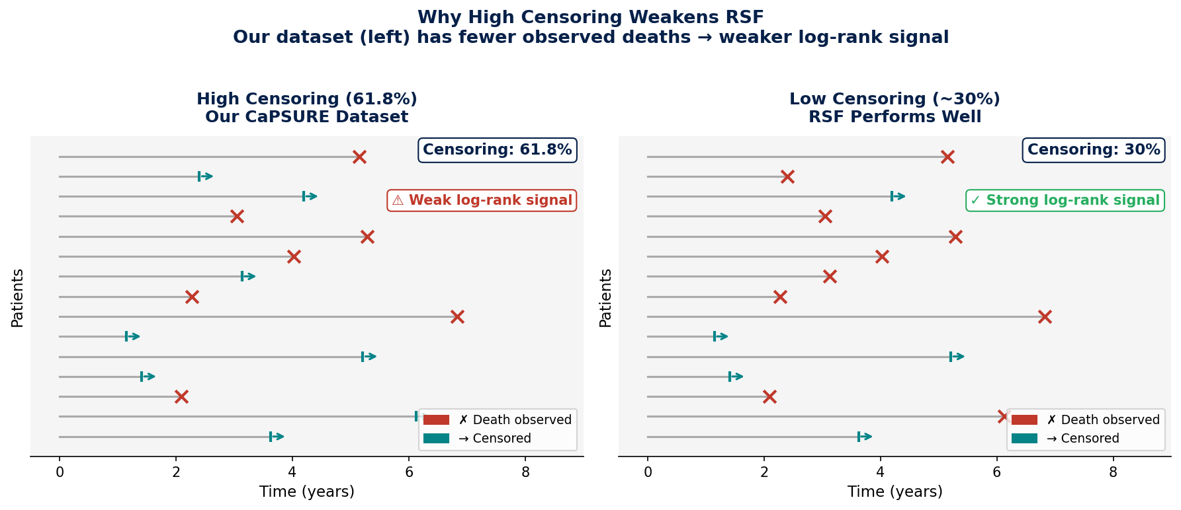
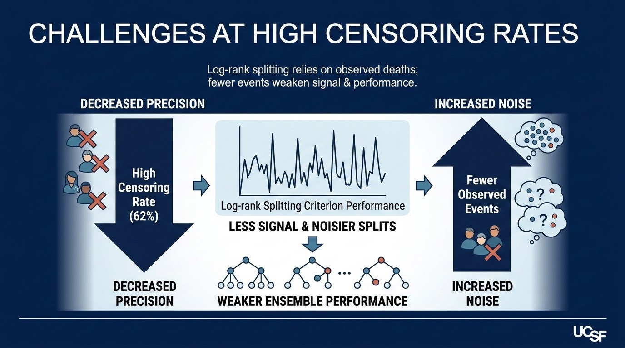
Why High Censoring Weakens RSF?
Notes:
However, RSF also struggles at high censoring rates. The log-rank splitting criterion depends on observed deaths to measure survival differences between groups. In our dataset, 61.8% of the patients are censored, with fewer deaths per node, the log-rank statistic has less signal to work with. Splits become nosier, trees become less stable, and the ensemble weakens. Berkowitz et al confirmed this in a 2024 simulation study, and log-rank RSF performed consistently below average at high censoring rates across many different data settings. The recommended Rotation survival forest, which applies PCA to covariate subsets before observed events. However, this will be a future direction for our analysis.

Slide 7
Application: PDI and All-Cause Mortality in CaPSURE Prostate Cancer Survivors
N = 1,813
693 Deaths (38.2%)
61.8% Censoring
Median Follow-up 6.0 yrs
C-Index: P(patient who died first had higher predicted risk)
Range: 0.5 = random, 1.0 = perfect
IBS: mean squared error between predicted S(t) and observed outcome
Range: 0 = perfect, 0.25 = null model
Model
C-index
IBS
Cox PH
0.705
0.111
RSF (log-rank)
0.698
0.116
C-index: higher = better discrimination | IBS: lower = better calibration
Cox marginally outperformed RSF;
PDI-ACM relationship is approximately linear (confirmed by Martingale residuals)
RSF variable importance: age_ffq dominates (0.103) | PDI ranks 12th (0.001) ;
Consistent with Cox finding
High censoring (61.8%) attenuated RSF performance; RotSF recommended for future work
Ishwaran et al., Ann Appl Stat, 2008 | Berkowitz et al., Int J Biostat, 2024
Notes:
I will briefly show the results from our CaPSURE analysis. We had 1813 prostate cancer survivors, 693 deaths, a 38.2% event rate, and 61.8% censoring over a median follow-up of 6 years.
We evaluated models using 2 metrics. The C-index, which is Harrell’s concordance index, it measures discrimination of the model . It is the probability that for a randomly selected pair of patients, the one who died first had the higher predicted risk score. It ranges from 0.5 which is random prediction to 1.0 which is perfect. The Integrated Brier Score measures calibration, which is how close predicted survival probabilities are to actual outcomes. Lower is better. A null model that predicts 50% survival for everyone scores 0.25 so both our models are well above that.
Cox PH achieved a C-index of 0.705 and IBS of 0.111. RSF achieved 0.698 and 0.116. Both metrics tell the same story, that cox marginally outperformed RSF.
The explanation here is first, Martingale residual analysis showed the PDI-ACM relationship is approximately linear, so RSF’s ability to capture nonlinear effect was not very effective here. Second, the 61.8% censoring rate attenuated RSF’s performance. RSF variable importance showed age at FFQ completion dominated ACM prediction, confirming this population died primarily from age-related causes, not cancer. PDI ranked 12th and is consistent with the Cox Hazard ratio of 0.983 (10-unit increment will be 0.844). RSF and Cox are complementary tools. Cox gives interpretable hazard ratios. RSF gives you model-agnostic variable importance with no distributional assumptions.

Slide 8
References:
Ishwaran H, Kogalur UB, Blackstone EH, Lauer MS. Random survival forests. Ann Appl Stat. 2008;2(3):841–860. doi:10.1214/08-AOAS169
Berkowitz M, MacKay Altman R, Loughin TM. Random forests for survival data: which methods work best and under what conditions? Int J Biostat. 2024;20(2):315–345. doi:10.1515/ijb-2023-0056
Zhou L, Xu Q, Wang H. Rotation survival forest for right censored data. PeerJ. 2015;3:e1009. doi:10.7717/peerj.1009
Harrell FE, Lee KL, Mark DB. Multivariable prognostic models: issues in developing models, evaluating assumptions and adequacy, and measuring and reducing errors. Stat Med. 1996;15(4):361–387.
Graf E, Schmoor C, Sauerbrei W, Schumacher M. Assessment and comparison of prognostic classification schemes for survival data. Stat Med. 1999;18(17–18):2529–2545.
Pölsterl S. scikit-survival: a library for time-to-event analysis built on top of scikit-learn. J Mach Learn Res. 2020;21(212):1–6.
Therneau TM, Grambsch PM. Modeling Survival Data: Extending the Cox Model. New York: Springer; 2000.
Breiman L. Random forests. Mach Learn. 2001;45(1):5–32. doi:10.1023/A:1010933404324

